Slide 1
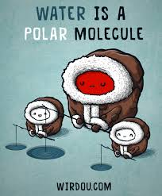
Water
The most abundant molecule in living things

Slide 2
What is Water?
Water makes up 60-70% of the total body weight of most living things.
Water is a polar molecule.
Electrons spend more time circulating the larger oxygen atom and therefore give it a slight negative charge.
The result is a slight positive charge on the hydrogen atoms.
92% of our blood is water.

Slide 3
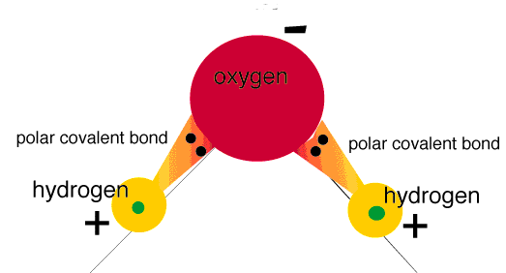
A Polar Molecule
Remember from last class? Water is a polar covalent molecule held together by polar covalent bonds between H and O atoms

Slide 4
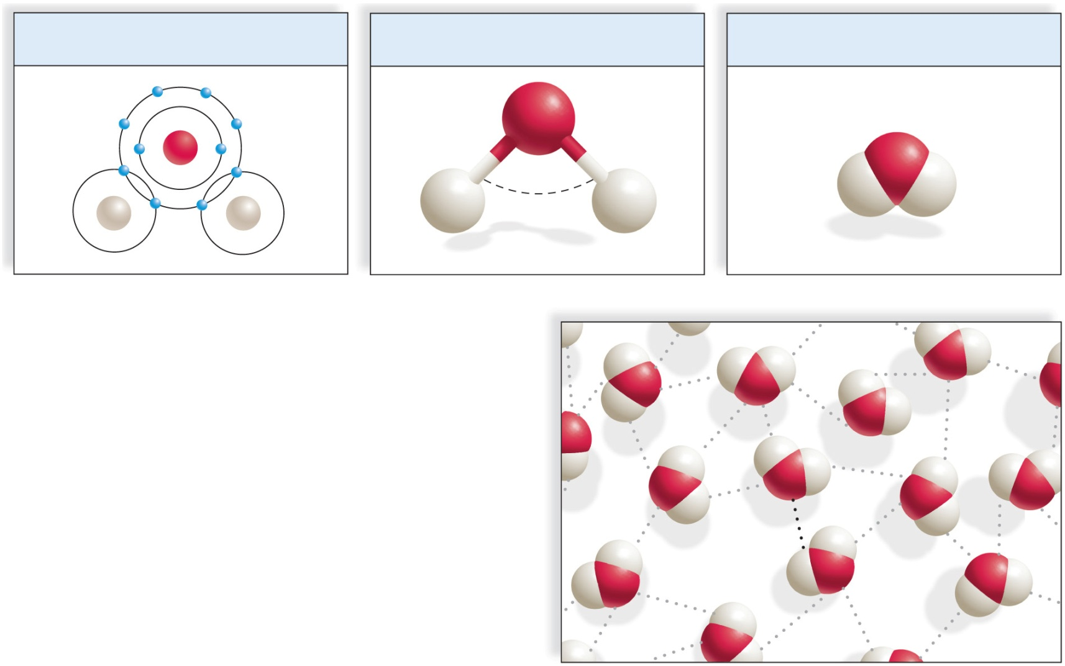
Water Molecule
Copyright © The McGraw-Hill Companies, Inc. Permission required for reproduction or display.
Electron Model
Ball-and-stick Model
Space-filling Model
Oxygen attracts the shared
electrons and is partially negative.
O
δ–
O
O
H
H
H
104.5°
H
H
H
δ⁺
δ⁺
Hydrogens are partially positive.
a. Water (H₂O)
δ⁺
H
H
δ–
O
δ⁺
hydrogen
bond
b. Hydrogen bonding between water molecules

Slide 5
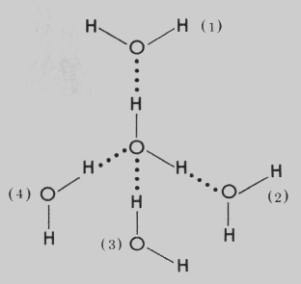
Why is water so important to life?
Because water is a polar covalent molecule, the slightly positive H regions of one water molecule will attract the slightly negative O regions of another water molecule
This electrical attraction between the water molecules is called hydrogen bonding

Slide 6
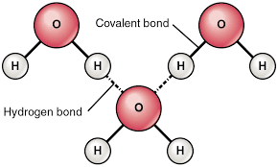
Intra vs. Inter?
Which bonds are intermolecular?
_______________________________
Which bonds are intramolecular?
_______________________________
The extraordinary properties of water are due to water’s intramolecular polar covalent bonds and intermolecular hydrogen bonds
Notes:
Inter = H- Bonds
Intra = covalent bonds

Slide 7
Hydrogen Bonds
A hydrogen bond occurs when a covalently bonded positive hydrogen atom is attracted to a negatively charged atom.
A hydrogen bond is represented by a dotted line and is a relatively weak bond.
In water the slightly positive hydrogen atom forms a hydrogen bond with the slightly negative oxygen atom in another water molecule.

Slide 8
Properties of Water
1. Water is a liquid at room temperature until 100ºC.
2.Water is a universal solvent for polar charged molecules.
3. Water molecules are cohesive (cling together).
4. The temperature of liquid water has a high specific heat capacity.
5. Water has a high heat of vaporization.
6. Solid water (ice) is less dense that liquid water.

Slide 9
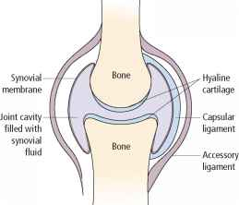
1. Water is a Liquid at Room Temp.
a). Most low mass molecules are gases at room temperature. (Ex: methane, oxygen, ammonia..)
The hydrogen bonds in water keep it a liquid and not a gas at room temperature until 100ºC.
Without hydrogen bonds, our body fluids would be gaseous.
b). Water as a liquid is a
good lubricant
(ex: joints)

Slide 10
2. Water is a Universal Solvent
Water facilitates chemical reactions both outside and inside our bodies:
There are 2 parts to a solution: Solvent and Solute.
Water is a good solvent (most abundant part) for dissolving solutes (less abundant part of a solution)
Hydrophilic molecules and ions are polar molecules that interact with water molecules and readily dissolve. (“Likes dissolve likes”)
Hydrophobic molecules are nonpolar and nonionized molecules that do NOT interact with water or only dissolve slightly.

Slide 11
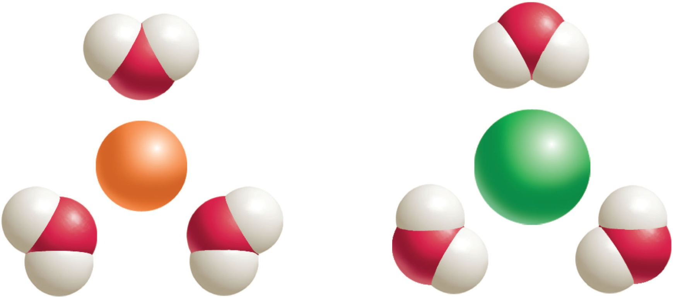
Properties of Water: Water as a Solvent (Water dissolves Ionic compounds)
δ⁻
O
H
H
H
H
O
δ⁻
An ionic salt
dissolves in water.
δ⁺
δ⁺
Na⁺
δ⁺
Cl–
δ⁺
H
δ⁻
δ⁻
H
H
H
O
O
O
H
O
H
H
H
H

Slide 12
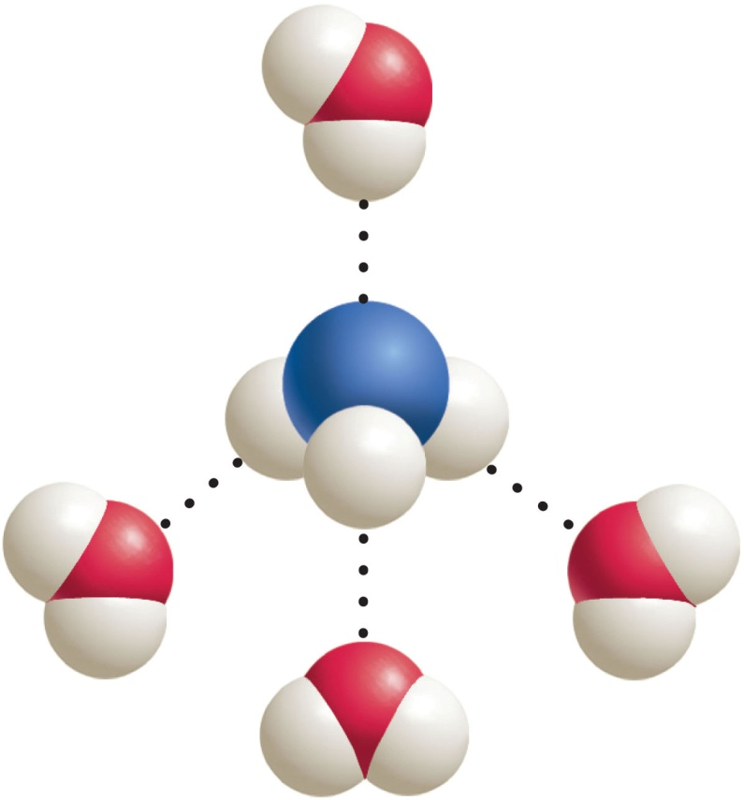
Properties of Water: Water as a Solvent. Water dissolves polar molecules
A polar molecule
dissolves in water.
H
O
H
δ⁺
δ⁺
δ⁻
δ⁺
N
δ⁺
H
H
H
H
O
δ⁻
δ⁺
δ⁻
O
H
H
δ⁻
H
O
H
H

Slide 13
3. Water is Cohesive
Hydrogen bonding causes water molecules to cling together and yet also to flow.
Water is an excellent medium to transport dissolved and suspended molecules throughout the body.
Cohesion is different than adhesion. The difference between them is that adhesion refers to the clinging of unlike molecules and cohesion refers to the clinging of like molecules.

Slide 14
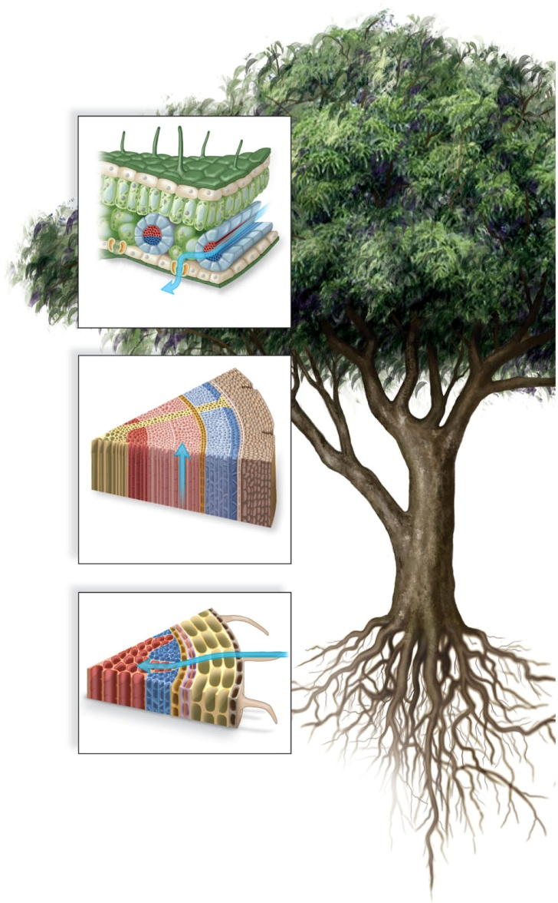
Ex: Water is Cohesive
Water evaporates, pulling the water
column from the roots to the leaves.
H₂O
Water molecules cling together and
adhere to sides of vessels in stems.
Water enters a plant at root cells.
H₂O

Slide 15
4. Water has a High Heat Capacity
Water has a high heat capacity
Temperature = rate of vibration of molecules
Apply heat to liquid
Molecules move faster
Increases temperature of liquid
But, when heat applied to water
Hydrogen bonds restrain bouncing and enable water to absorb a considerable amount of heat before the temperature changes.
Temperature rises more slowly per unit heat
Water at a given temp. has more heat than most liquids
Thermal inertia – resistance to temperature change
A calorie is the energy is takes to raise the temperature of one gram of water 1ºC. (This is approx. twice the amount of heat for most other covalently bonded liquids.)
Also, more heat is extracted/released when lowering water one degree than most other liquids
This ability of water helps humans maintain homeostasis.

Slide 16
5. High Heat of Vaporization
To raise water from 98 to 99 ºC; ~1 calorie
To raise water from 99 to 100 ºC; ~1 calorie
However, large numbers of hydrogen bonds must be broken to evaporate water
To raise water from 100 to 101 ºC; ~540 calories!
When water does evaporate, it gives off this heat. That is why you feel cooler after sweating (panting).
Water’s high heat of vaporization also helps moderate Earth’s temperature for life to exist.

Slide 17
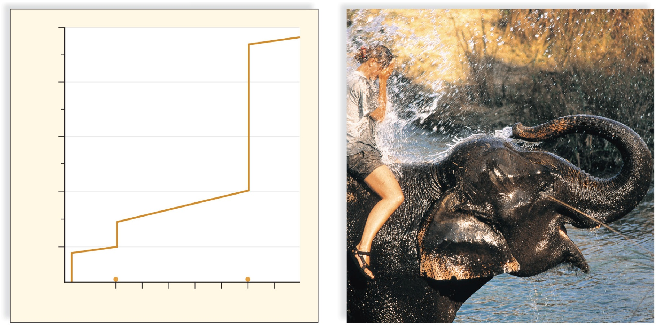
Evaporative Cooling of Animals
Copyright © The McGraw-Hill Companies, Inc. Permission required for reproduction or display.
800
Gas
600
540
calories
400
Calories of Heat Energy / g
200
Liquid
Solid
80 calories
0
freezing occurs
evaporation occurs
0
20
40
60
80
100
120
Temperature (°C)
a. Calories lost when 1 g of liquid water freezes and
calories required when 1 g of liquid water evaporates.
b. Bodies of organisms cool when their heat is used
to evaporate water.
© Grant Taylor/Getty Images

Slide 18
6. Ice is Less Dense than Water
Frozen water is less dense than ice.
Water is densest at 4ºC.
Temperatures lower than 4ºC cause hydrogen bonds to become more rigid.
The hydrogen bonds also keep the molecules further apart and therefore ice is less dense.
This property enables lakes to freeze from the top down. Ice acts as an insulator on top of the frozen body of water.

Slide 19
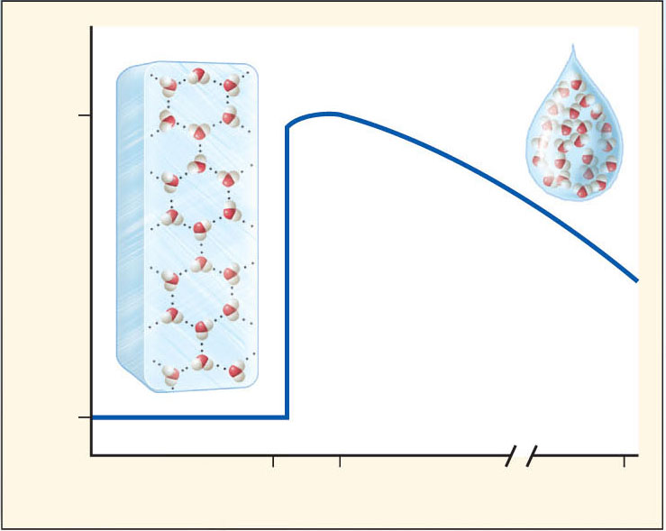
Density of Water at Various Temperatures
Copyright © The McGraw-Hill Companies, Inc. Permission required for reproduction or display.
ice lattice
1.0
liquid water
Density (g/cm³)
0.9
0
4
100
Temperature (ºC)

Slide 20
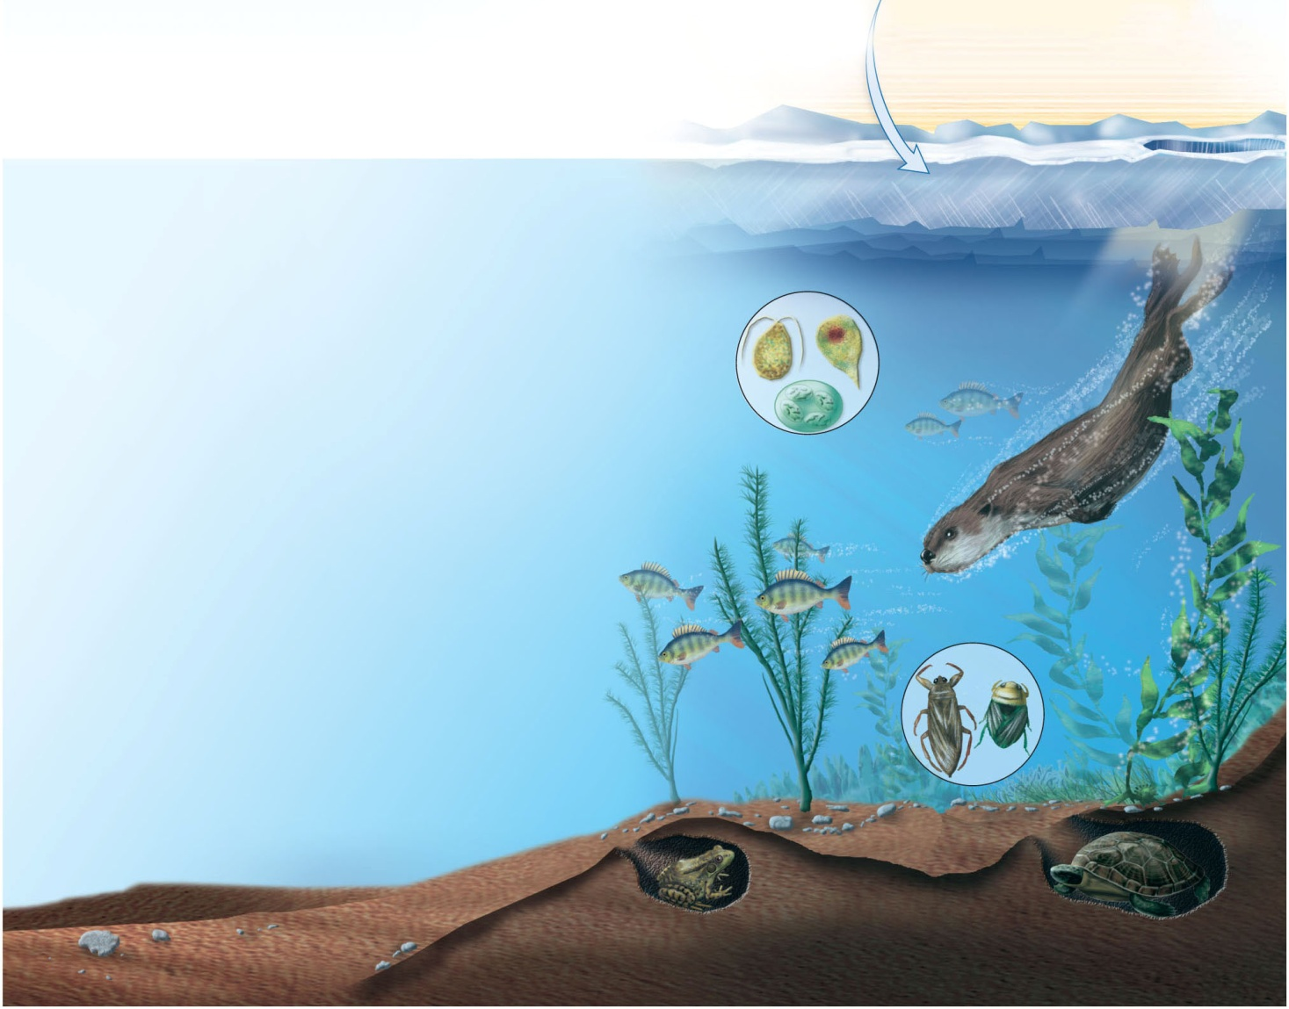
A Pond in Winter
Copyright © The McGraw-Hill Companies, Inc. Permission required for reproduction or display.
ice layer
Protists provide
food for fish.
River otters visit
ice-covered ponds.
Aquatic insects survive
in air pockets.
Freshwater
fish take
oxygen
from water.
Common frogs and pond turtles hibernate.

